Slide 1

CSE (H) with specialization in Machine Learning and Artificial Intelligence
Soft Computing
Chapter -1.2
By: Dr. Monika Singh E11032
DISCOVER . LEARN . EMPOWER

Slide 2
Course Objectives
To introduce soft computing concepts and techniques of artificial neural networks, fuzzy sets, fuzzy logic and genetic algorithms
To understand the various techniques from the application point of view.
To analyze various soft computing techniques and decide the technique to be used in a particular problem situation.
To implement soft computing based solutions for real-world problems

Slide 3
Course Outcomes
CO1 | Identify and describe soft computing techniques and their roles in building intelligent. Machines | 1
CO2 | Recognize the feasibility of applying a soft computing methodology for a particular problem. | 2,4
CO3 | Apply fuzzy logic and reasoning to handle uncertainty and solve engineering problems, genetic algorithms to combinatorial optimization problems and neural networks to pattern classification and regression problems. | 3
CO4 | Effectively use modern software tools to solve real problems using a soft computing approach. | 3
CO5 | Evaluate various soft computing approaches for a given problem. | 4

Slide 4
Table of Contents
Neural network and its working
Architectures,
learning rules for neural network.

Slide 5
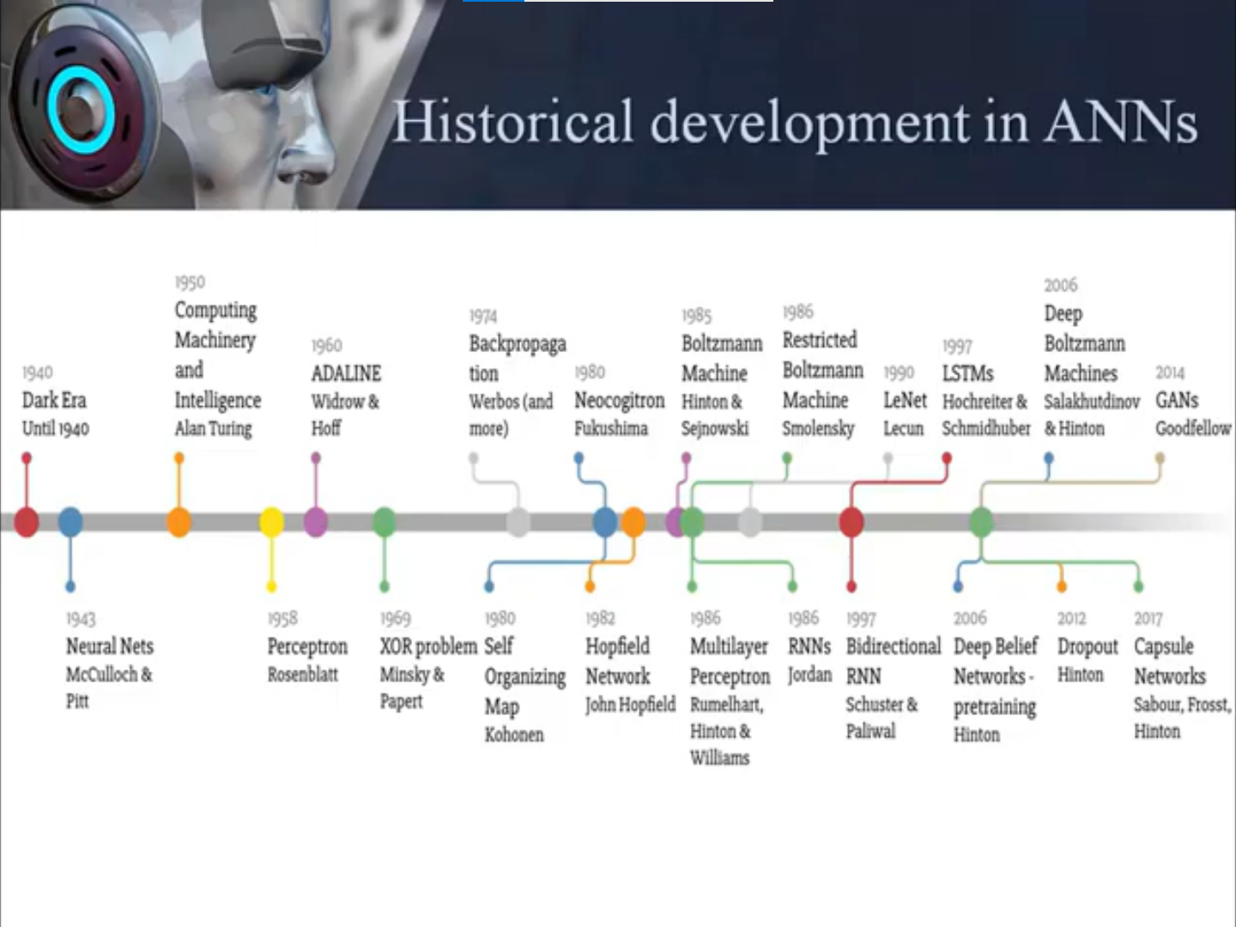

Slide 6
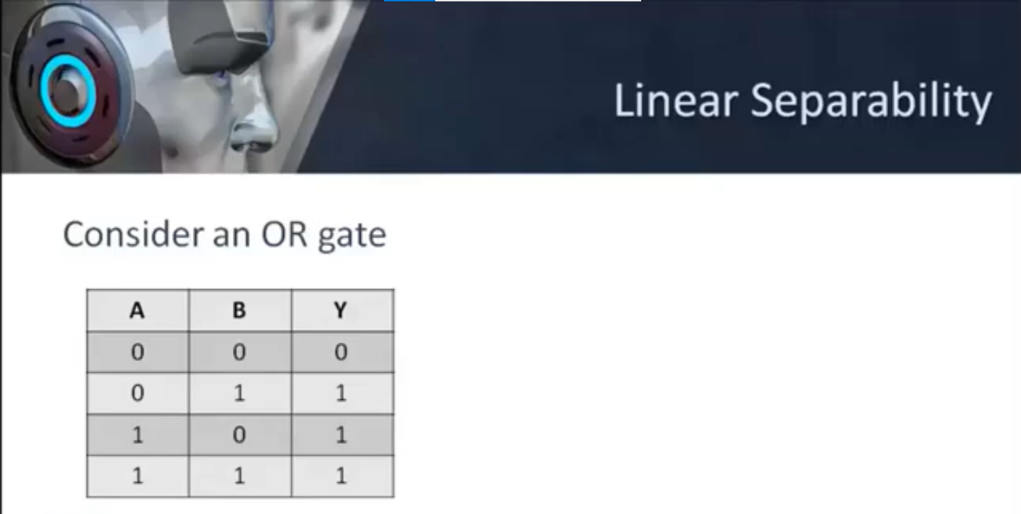

Slide 7
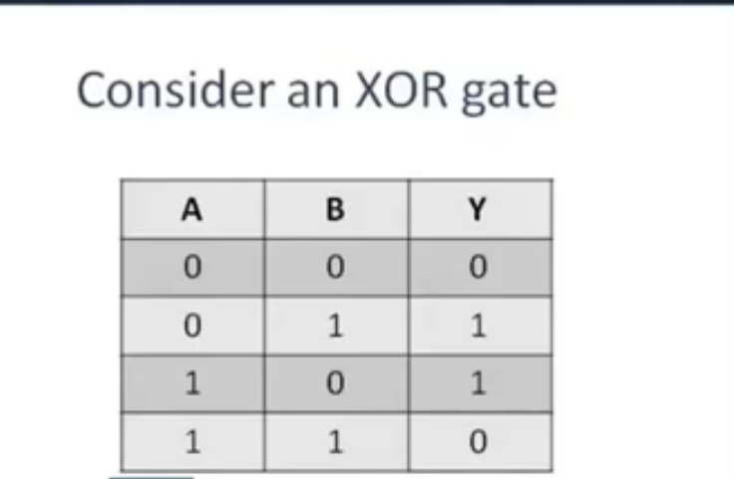

Slide 8
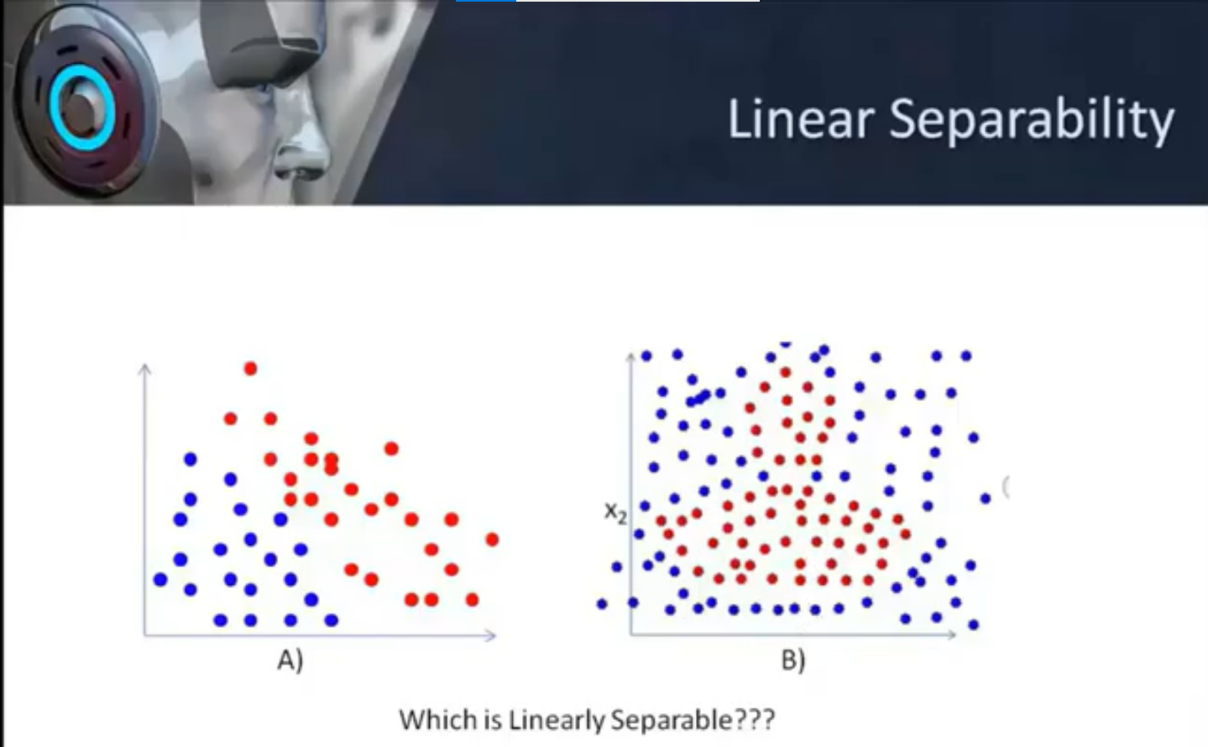
http://vlabs.iitkgp.ac.in/scte/exp5/perceptron-js-simulator.html

Slide 9
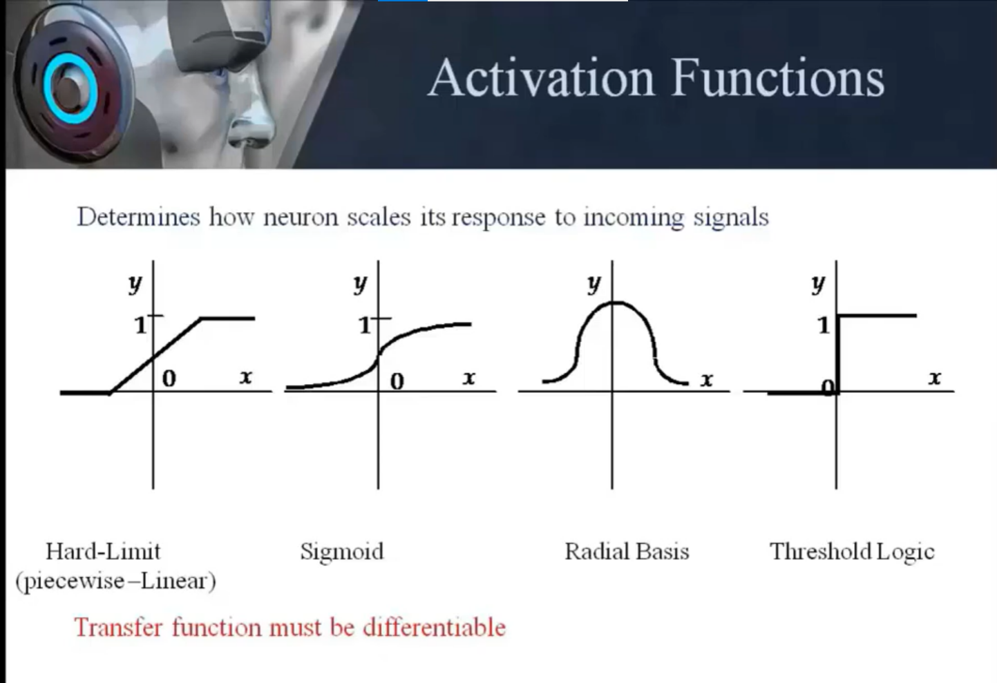

Slide 10
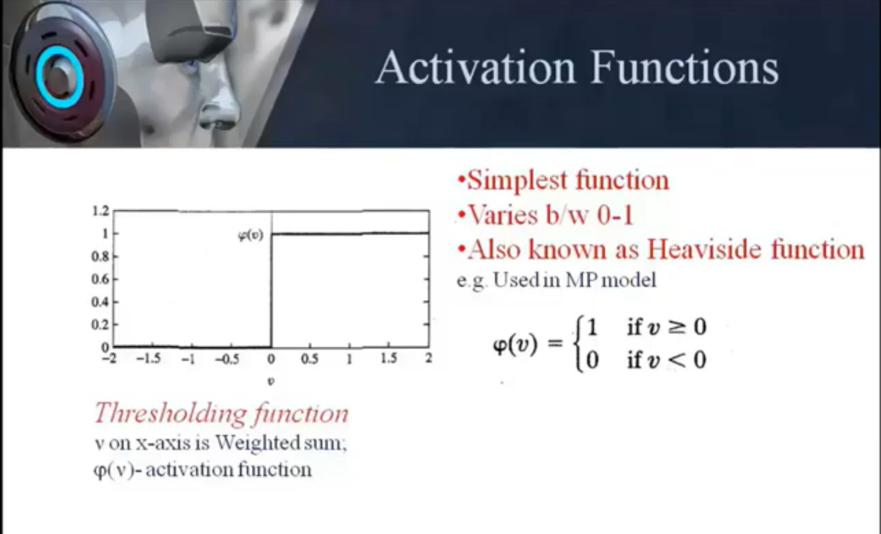

Slide 11
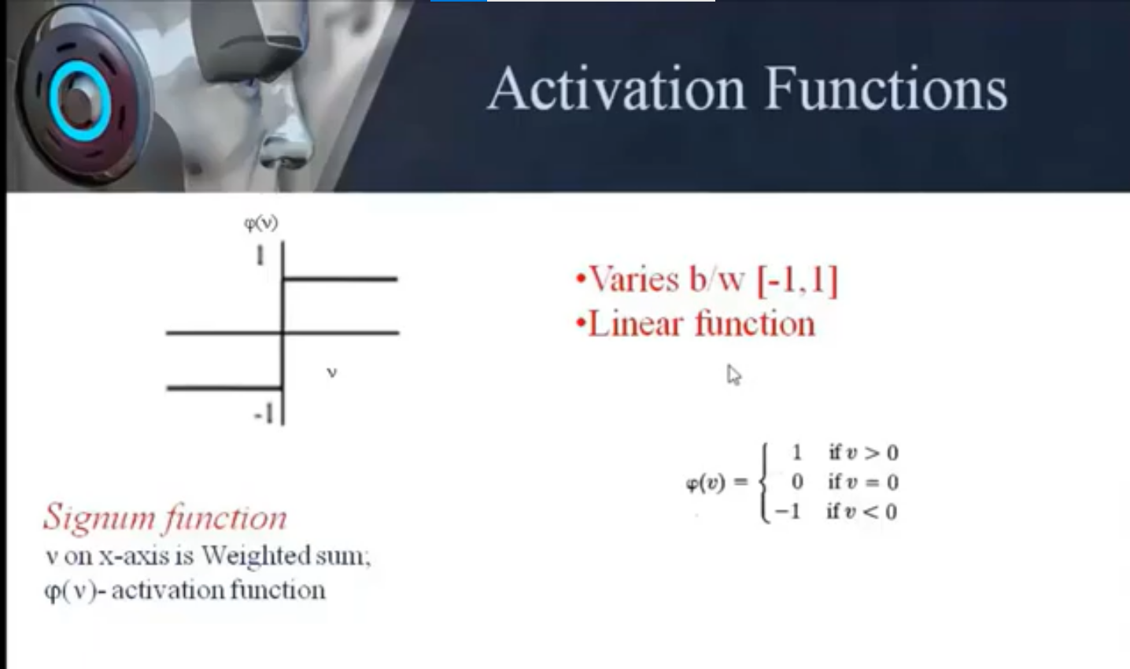

Slide 12
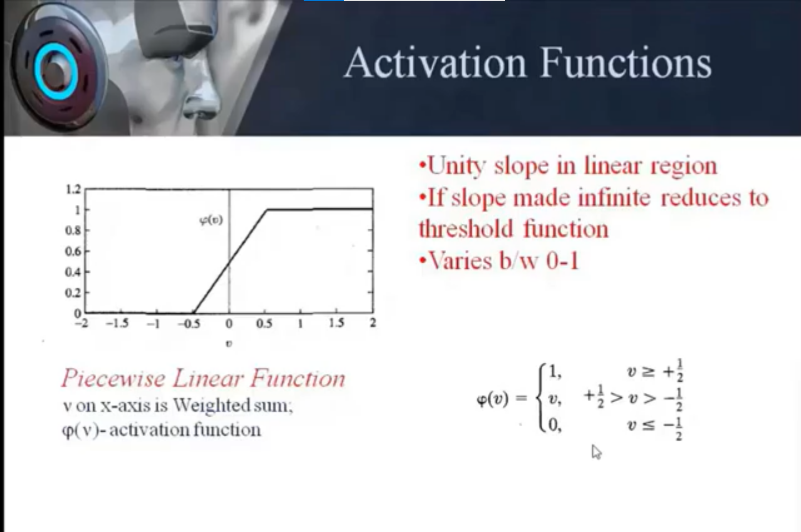

Slide 13
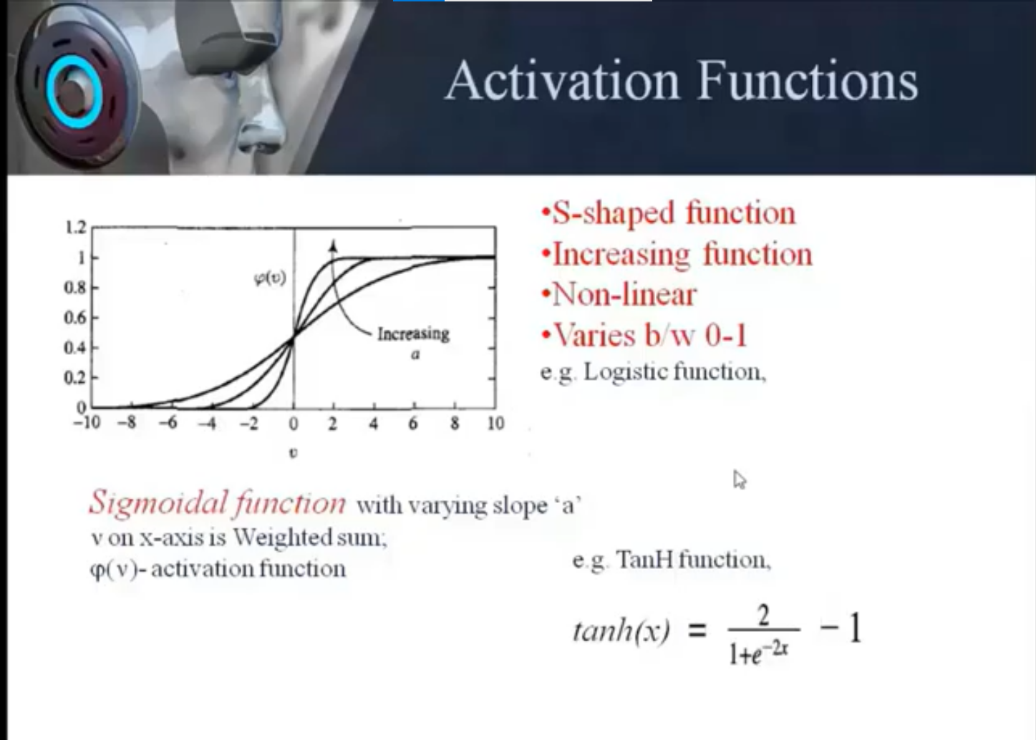

Slide 14
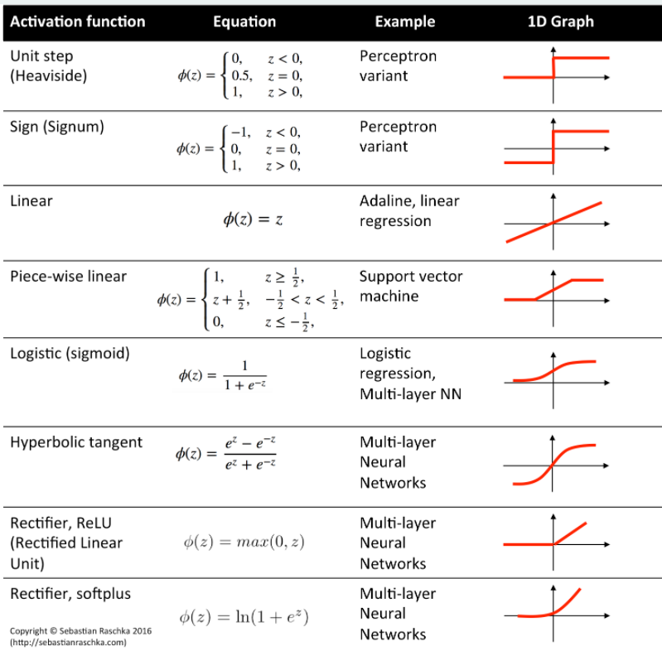

Slide 15
References
Main text books:
• “Neural Networks: A Comprehensive Foundation”, S. Haykin (very
good -theoretical)
• “Pattern Recognition with Neural Networks”, C. Bishop (very goodmore
accessible)
• “Neural Network Design” by Hagan, Demuth and Beale
(introductory)
Books emphasizing the practical aspects:
• “Neural Smithing”, Reeds and Marks
• “Practical Neural Network Recipees in C++”’ T. Masters
• Seminal Paper (but now quite old!):
– “Parallel Distributed Processing” Rumelhart and McClelland et al.
Deep Learning books and tutorials:
• http://www.deeplearningbook.org/
Introduction to Learning Rules in Neural Network - DataFlair (data-flair.training)

Slide 16
Neural Networks Literature
Review Articles:
R. P. Lippman, “An introduction to Computing with Neural Nets”’ IEEE
ASP Magazine, 4-22, April 1987.
T. Kohonen, “An Introduction to Neural Computing”, Neural Networks,
1, 3-16, 1988.
A. K. Jain, J. Mao, K. Mohuiddin, “Artificial Neural Networks: A Tutorial”’
IEEE Computer, March 1996’ p. 31-44.
Journals:
IEEE Transactions on NN
Neural Networks
Neural Computation
Biological Cybernetics

Slide 17
THANK YOU
For queries
Email: monika.e11032@cumail.in

